Slide 1
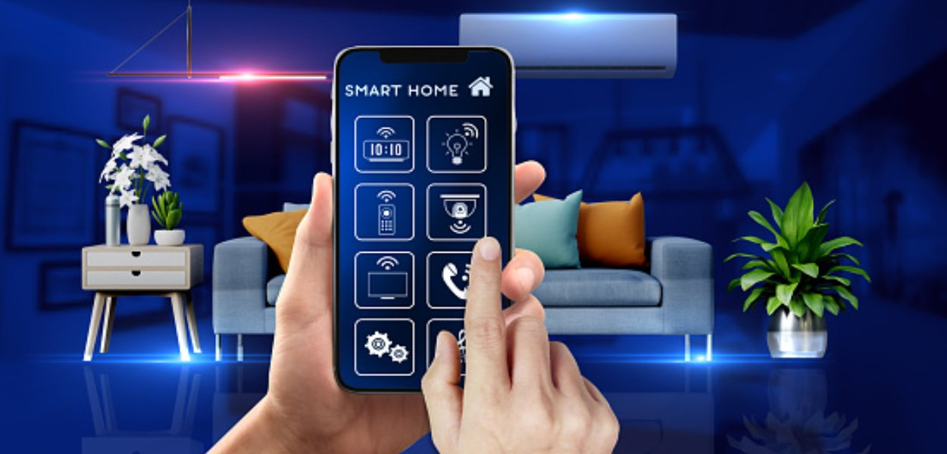
SMART HOME AUTOMATION

Slide 2


CONTENT
01
ABOUT US
02
OUR TEAM
03
PRODUCT
04
OUR SERVICES
05
REAL TIME FEEDBACK
06
CONCLUSION

Slide 3

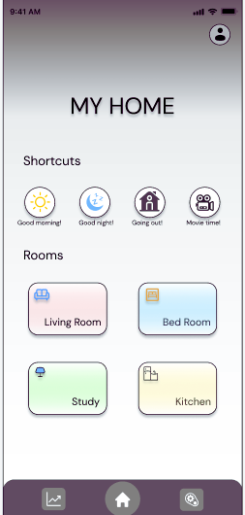
About Us
At Smart Home Automation ,our mission is to revolutionize the way people interact with their homes. We believe that automation shouldn't be limited to the wealthy; it should be available to all households. Our goal is to design an efficient and cost-effective solution that brings comfort, convenience, and energy efficiency to every home.
Introducing our cutting-edge home automation solution - an all-in-one package that empowers you to control various appliances at your fingertips. Our smart app and automation chip work seamlessly together to create a powerful home automation experience.

Slide 4
OUR TEAM
Aswin Beckham N
Boda Sindhu Priyadharshini
Manish Kumar
Piyush swarke

Slide 5
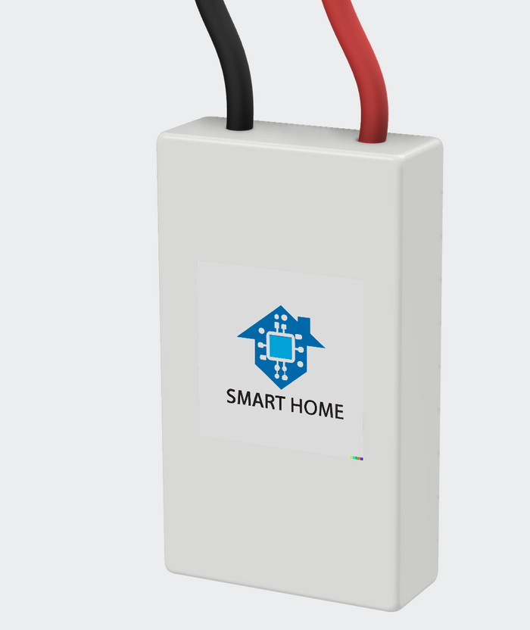
Our
Product
Smart Chip
Connects to any electronic device and makes it a smart house appliance
Connects to smart app, enables transformation of a normal house to smart house.
Ease of adapting
Compatible with all electronic devices.
Easy installation using magnets to snap to devices
Energy optimisation
Machine learning feature in app, enables advanced personalisation, and improves energy efficiency.
Provides smart recomendations and feedbacks to user.

Slide 6
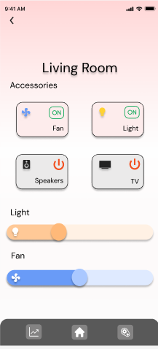
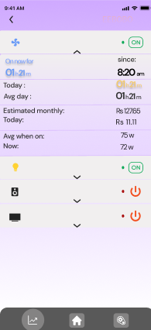
Our
Services
EASY TO ACCESS
Our user-friendly mobile app puts the power of automation in your hands. Its intuitive interface allows you to effortlessly manage your devices, set schedules, and create personalized automation routines. With just a few taps, you can control your fans, lights, TVs, and much more, all from a single unified platform.

Slide 7
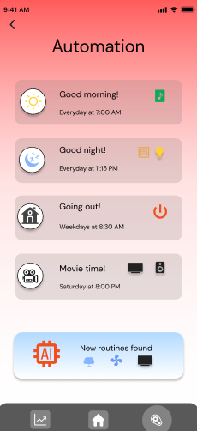
Real-Time Feedback
Intelligent Data Analysis
Personalized Automation
Smart Anomaly Detection
Our app utilizes machine learning algorithms to analyze real-time data.
The analysis provides valuable insights into energy consumption patterns.
Self-learning app tailors automation to individual user preferences.
Based on the data, the app optimizes automation settings for efficiency.
Automation schedules adapt in real-time based on changing usage patterns.
Advanced algorithms identify and address unusual device behavior for enhanced safety.

Slide 8
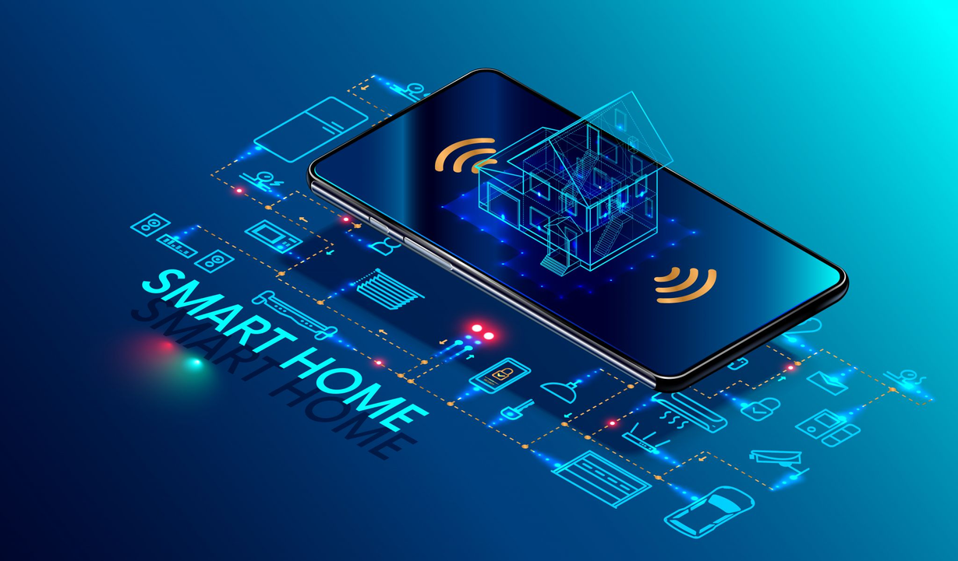
Conclusion
Smart Home Automation aims to revolutionize home interactions, making automation accessible to all households. Their cost-effective, all-in-one solution empowers users to control appliances effortlessly via a smart app and automation chip.
With a focus on comfort, convenience, and energy efficiency, their cutting-edge technology enhances daily living. They strive to widen accessibility, bringing sustainability and connectivity to more homes.
Join their journey towards a smarter future and embrace the boundless possibilities of smart home automation. Experience a safer, more efficient, and enjoyable living space.

Slide 9

Scan QR
Figma flow control representing a working prototype

Slide 10
Thank you!

